Slide 1
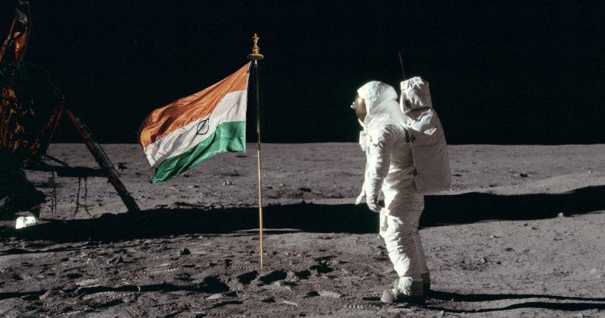
Space Technology-Space Mission India will launch its first crewed space mission by 2022
UNIT-1
Fundamentals of Rocketry

Slide 2
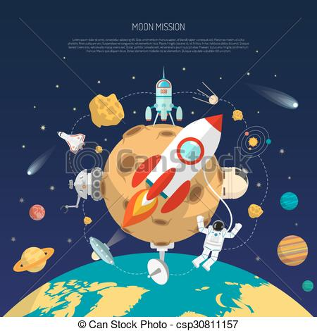
Space Mission
Contents
Space Mission
Types of Mission
Space Environment
Earth Atmosphere structure
Launch Vehicle Selection

Slide 3
Space Mission
What is the space mission?
What is the purpose of space mission?
What was the first mission to space?
What are the names of the space missions?
How many missions are in space?
What are the 4 types of space exploration?
When was the last space mission?

Slide 4
What is the space mission?
Space exploration is the discovery and exploration of celestial structures in outer space by developing and growing space technology.
While the study of space is carried out mainly by astronomers with telescopes, the physical exploration of space is conducted both by unmanned robotic space probes and human spaceflight.

Slide 5
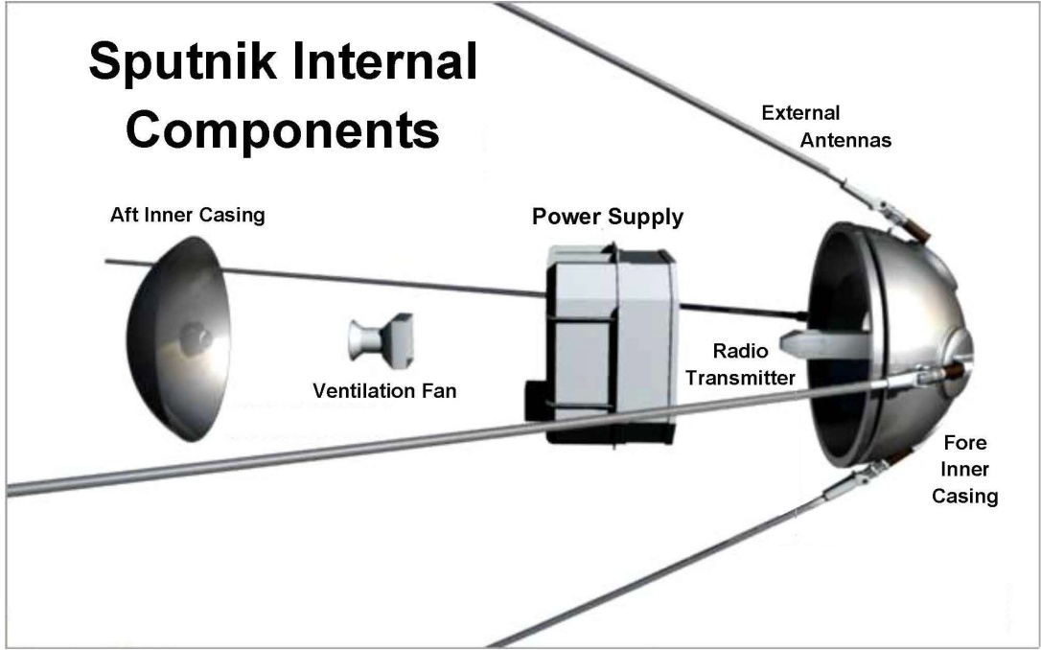
What was the first mission to space?
The first successful orbital launch was of the Soviet uncrewed Sputnik 1 ("Satellite 1") mission on 4 October 1957.
The satellite weighed about 83 kg (183 lb), and is believed to have orbited Earth at a height of about 250 km (160 mi)

Slide 6
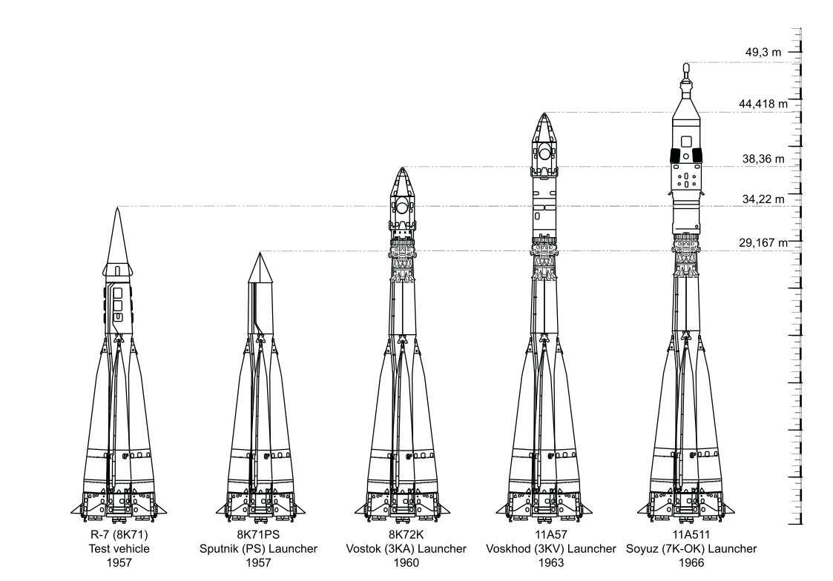
Sputnik Rocket

Slide 7
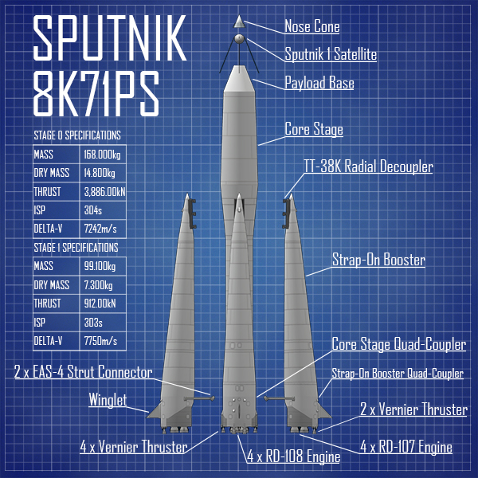

Slide 8
Specifications
First Stage: Block B, V, G, D (four strap-on boosters) Gross mass: 43.0 tons. Empty mass: 3.400 tons. ...
Second Stage: Block A (core stage) Gross mass: 94.0 tons. Empty mass: 7.495 tons. ...
Total mass: 267 tons (534,000 lb)
Total span: 10.303 metres (33.80 ft)
LEO payload: 500 kg.
Total liftoff thrust: 3.89 MN

Slide 9
What are the names of the space missions?
A History of Manned Space Missions
Mission (Country) Craft Launch Date
Gemini-Titan 10 (USA)Gemini 10July 18,1966
Gemini-Titan 11 (USA)Gemini 11September 12, 1966
Gemini-Titan 12 (USA)Gemini 12November 11, 1966
Apollo-Saturn 204 (USA)Apollo 1January 27, 1967

Slide 10
What are the 4 types of space exploration?
This lesson will go over four different types of space missions scientists have conducted, including flyby, orbiter, rover, and human space explorations.
Flyby Space Missions. ...
Orbiter Spacecraft. ...
Rovers.

Slide 11
Space shuttle Atlantis stands on Launch Pad 39A at NASA's Kennedy Space Center in Florida, where it is set to liftoff on STS-135, the final shuttle mission.
This story was updated at 4:51 p.m. EDT.
It's official: NASA's last space shuttle launch in history is set to blast off from Florida on July 8

Slide 12
How many missions are in space?
833: The total number of crewmembers of all 135 space shuttle missions, with some individuals riding multiple times and 14 astronauts killed during the Challenger and Columbia accidents.
789: The number of astronauts and cosmonauts who have returned to Earth on a NASA shuttle

Slide 13
The Space Environment
List and describe major hazards of the space environment and their effect on spacecraft.
To build spacecraft that will survive the harsh space environment, we must first understand what hazards they may face.
Earth, the Sun, and the cosmos combined offer unique challenges to spacecraft designer.

Slide 14
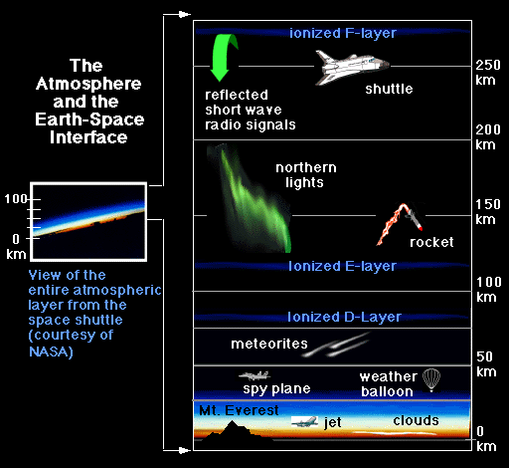
Space Environment

Slide 15
Space Environment
The gravitational environment causes some physiological and fluid containment problems but also provides opportunities for manufacturing
Earth’s atmosphere affects a spacecraft, even in orbit
The vacuum in space above the atmosphere gives spacecraft another challenge
Natural and man-made objects in space pose collision hazards
Radiation and charged particles from the Sun and the rest of the universe can severely damage unprotected spacecraft

Slide 16
Space Environment
Factors Affecting Spacecraft in the Space Environment. There are six challenges unique to the space environment we deal with
gravity,
the atmosphere,
vacuum,
micrometeoroids and debris,
radiation,
and charged particles

Slide 17
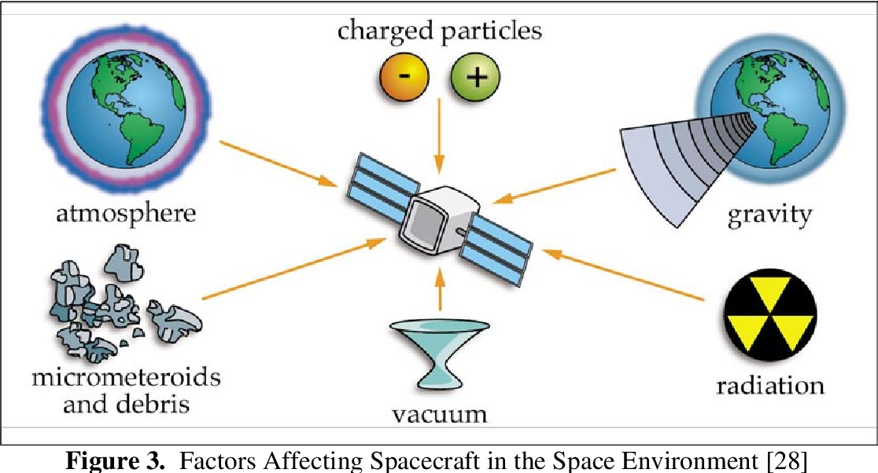
Space Environment

Slide 18
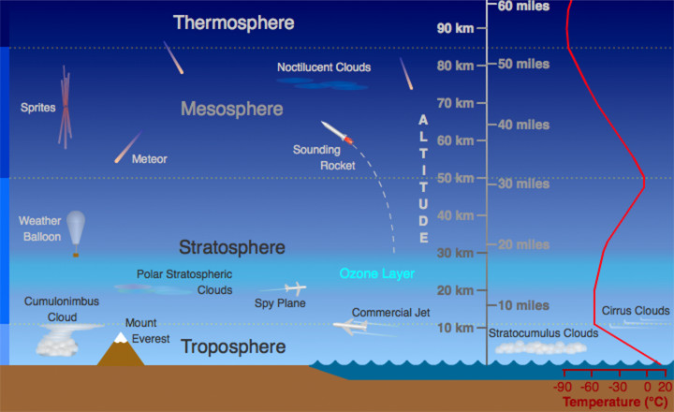
Earth Atmosphere

Slide 19
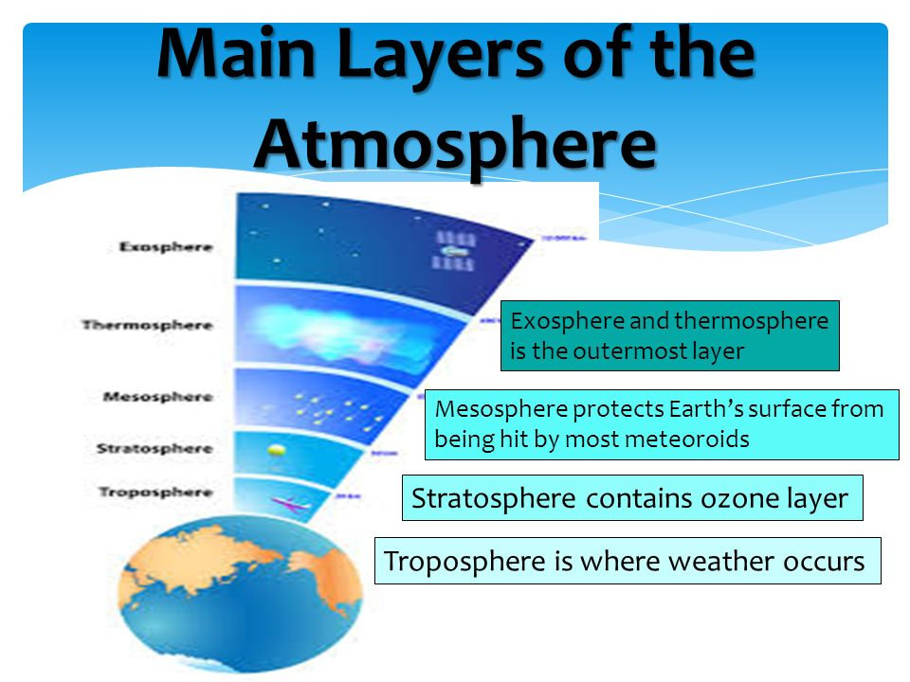

Slide 20
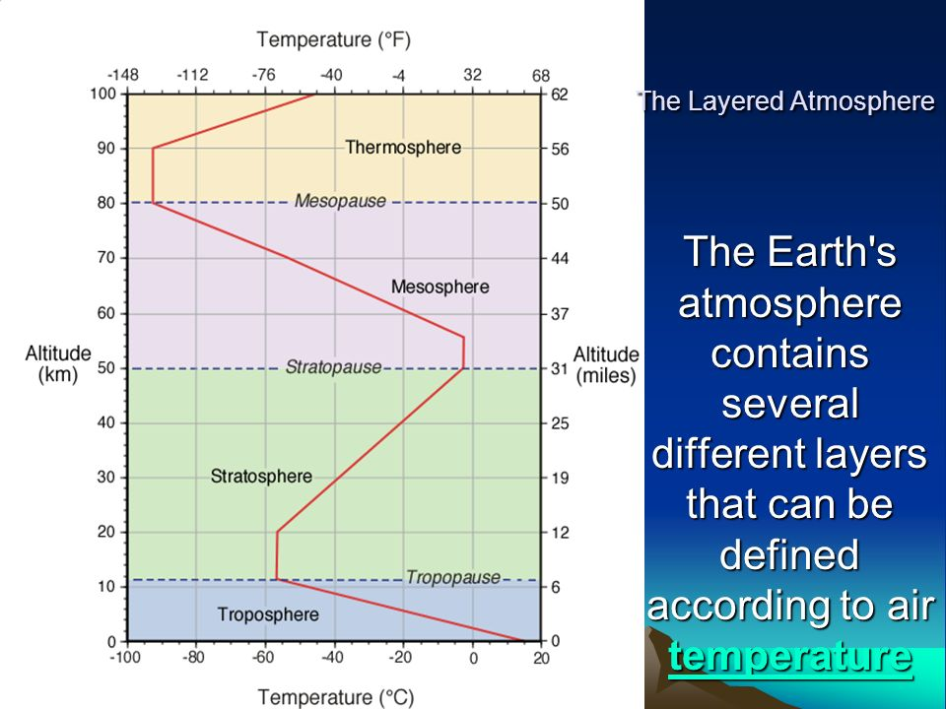

Slide 21
